Slide 1
TEAM-4
Ravi Teja Adapa(TeamLeader)
Anand Preetham
A N V Manoj
Harish
B Satyavani

Slide 2
Table of Contents
Invite a friend
Refer friend
Wall post/delete
User's wall
Status

Slide 3
Refer Friend
Similar to friend suggestion of Facebook. A user may suggest friend .

Slide 4
Refer Friend
Tables used from DB:
1. Friend request
2 User profile
MVC Layout:
1.Controller: Refer controller
2.Servicelayer: IReferservice, referservice
3.Daolayer: IReferdao

Slide 5
APPROACH:
On clicking the refer button, It displays the list of friends of a particular users.
As it is for refer a friend so it excludes mutual friends and displays the list.
For that I had used userid from userprofile(table) and receiverid, senderid from friendrequest(table).

Slide 6

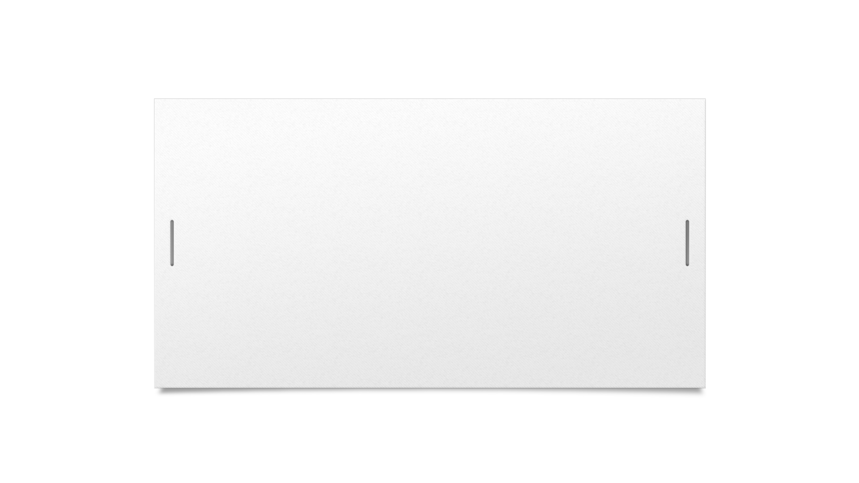

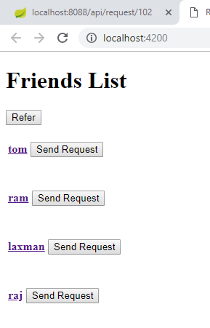


Screenshot

Slide 7
THANK YOU…

